Slide 1

Sounds Classification and Detection for Rain forest species using Custom CNN algorithm
By
Shreejaa Talla
Sri Vinesh Pothana

Slide 2
Outline
Motivation
Problem statement
Objectives
Research
Proposed idea
Challenges
Next Steps
Conclusion
References
Data
Data Pre-processing
Feature Extraction
Classification model

Slide 3
Motivation
Natural ambience and Sweet sounds
Impact climate change and habitat loss.
Problem Statement
Complex sound.

Slide 4
Objectives
.Use of acoustic technology to classify sound​.
. Audio clips are given as input and we’ll get type species as output.​
. The prediction is based on the acoustic sound of the different species.​

Slide 5
Research
Leaky – Relu.(X. Zhang, Y. Zou and W. Shi, "Dilated convolution neural network with LeakyReLU for environmental sound classification," 2017 22nd International Conference on Digital Signal Processing (DSP), London, 2017, pp. 1-5, doi: 10.1109/ICDSP.2017.8096153)
Combinations of different spectograms.(A. Dang, T. H. Vu and J. Wang, "Acoustic scene classification using convolutional neural networks and multi-scale multi-feature extraction," 2018 IEEE International Conference on Consumer Electronics (ICCE), Las Vegas, NV, 2018, pp. 1-4, doi: 10.1109/ICCE.2018.8326315).
Use of CNN Models.(T. Doan, H. Nguyen, D. T. Ngo, L. Pham and H. H. Kha, "Acoustic Scene Classification Using A Deeper Training Method for Convolution Neural Network," 2019 International Symposium on Electrical and Electronics Engineering (ISEE), Ho Chi Minh, Vietnam, 2019, pp. 63-67, doi: 10.1109/ISEE2.2019.8921365)

Slide 6
Proposed Solution Process
Labels
processing
Signal processing
And Audio
Augmentation
Feature
Extraction
Input
Predict
Test
Model
Train
Model
Normalization

Slide 7

DATA
There are always two types of datasets involved in classification.
Train dataset
Test dataset

Slide 8

TRAINING DATA OVERVIEW
Our Training data consist of :
4727 unlabeled audio recordings of the species
Two labelled csv files that consist information of the recordings
train_tp.csv - training data of true positive species labels, with corresponding time localization
train_fp.csv - training data of false positives species labels, with corresponding time localization

Slide 9
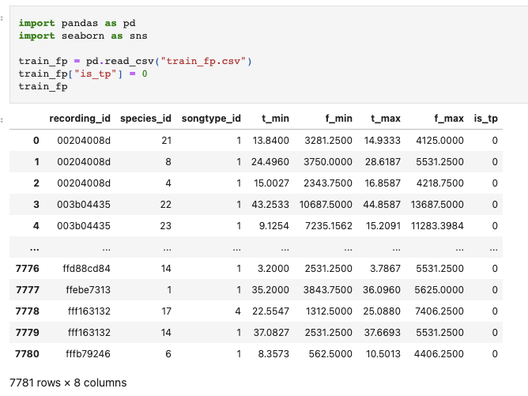
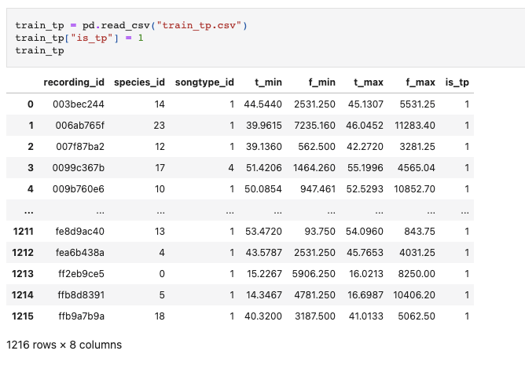
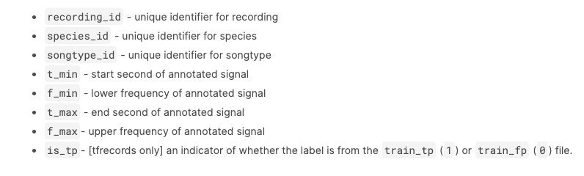
DATA FILES
Columns

Slide 10

TEST DATA OVERVIEW
This is the dataset that our model uses to provide unbiased evaluation
Out test data consists of 1992 unlabeled audio recording which is approximately 7GB
Sample unlabeled audio recording

Slide 11
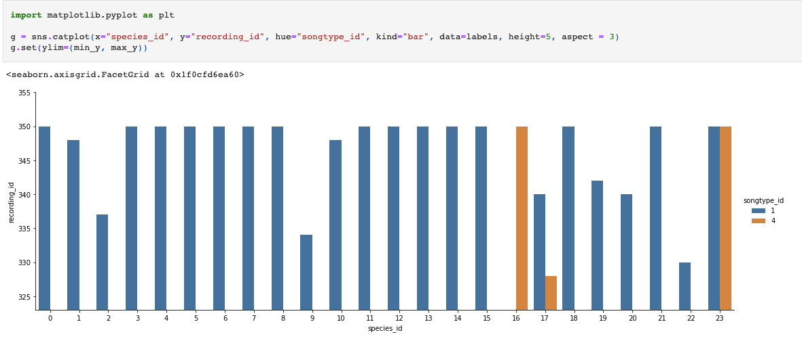
Label Class Distribution

Slide 12
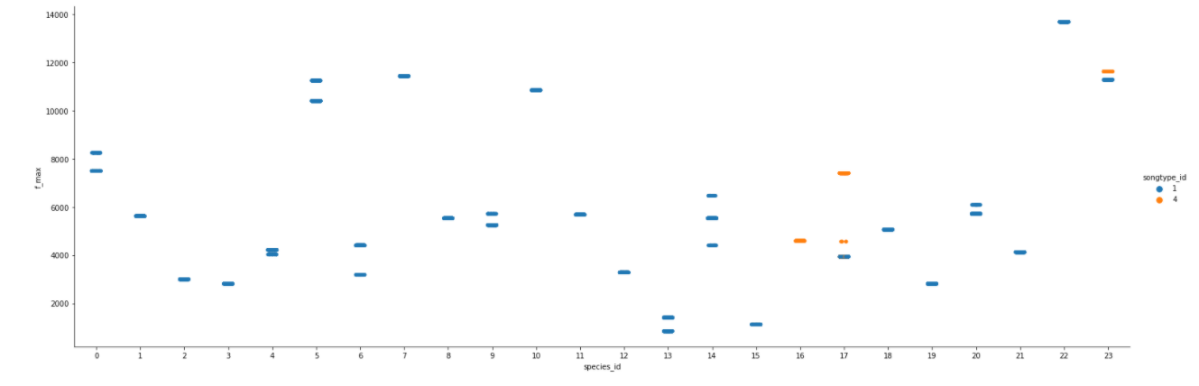
F-MAX OF THE SPECIES

Slide 13
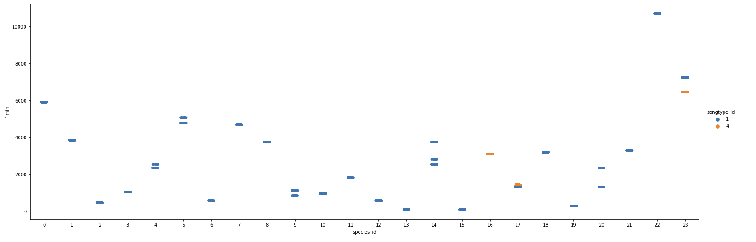
F-MIN OF THE SPECIES

Slide 14
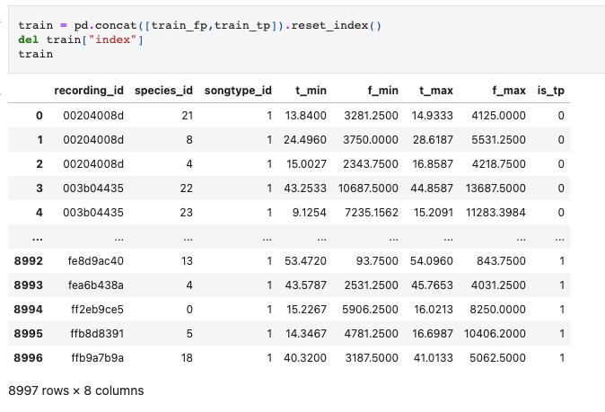
DATA PREPROCESSING
Concatenate tp and fp train.csv files by adding the is_tp column.

Slide 15
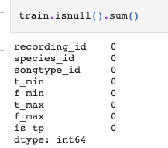
Check for NULL values

Slide 16
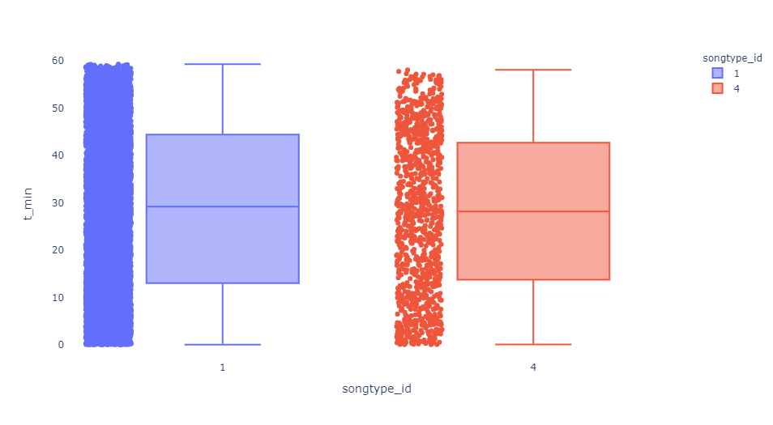
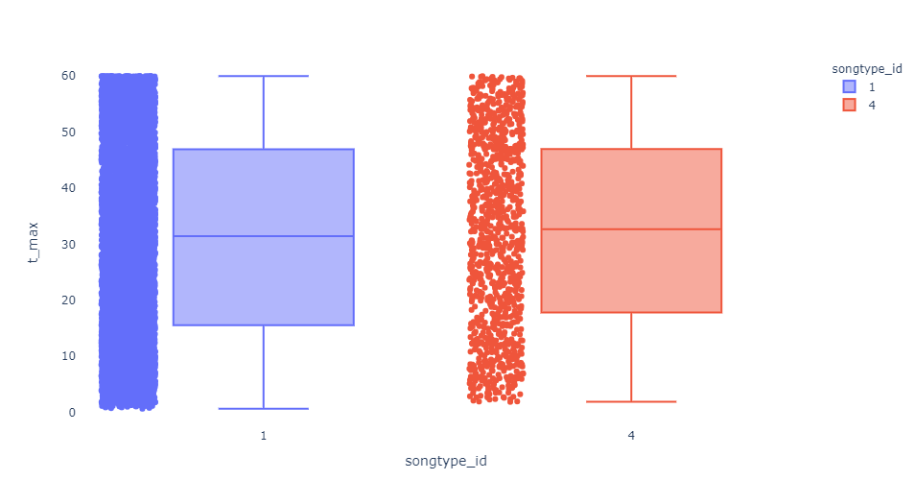
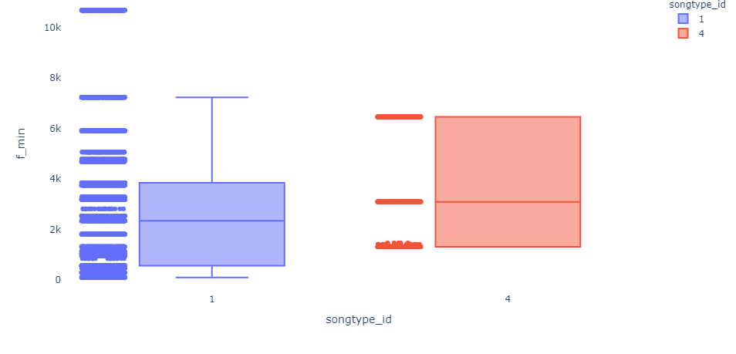
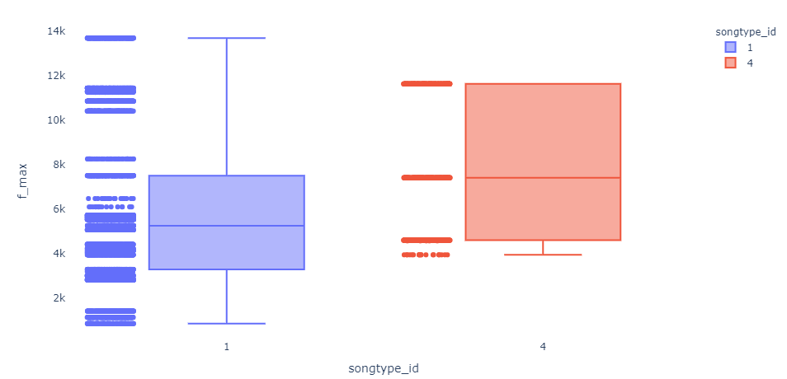
OUTLIER INFORMATION

Slide 17
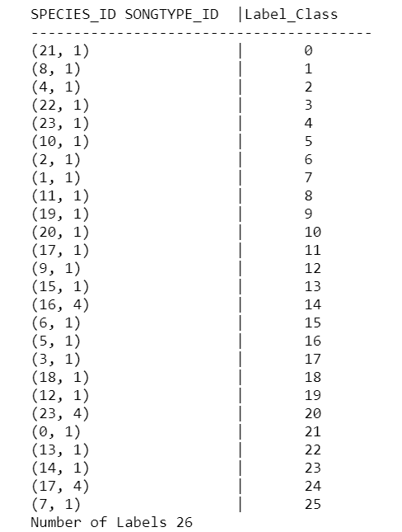
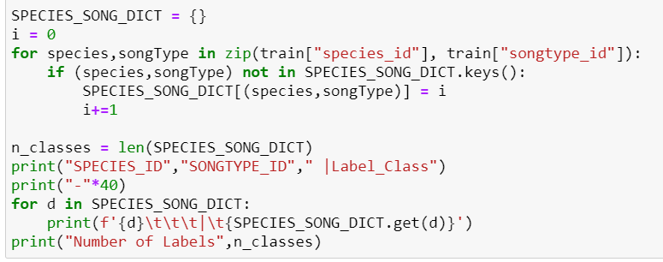
Processing the label data

Slide 18
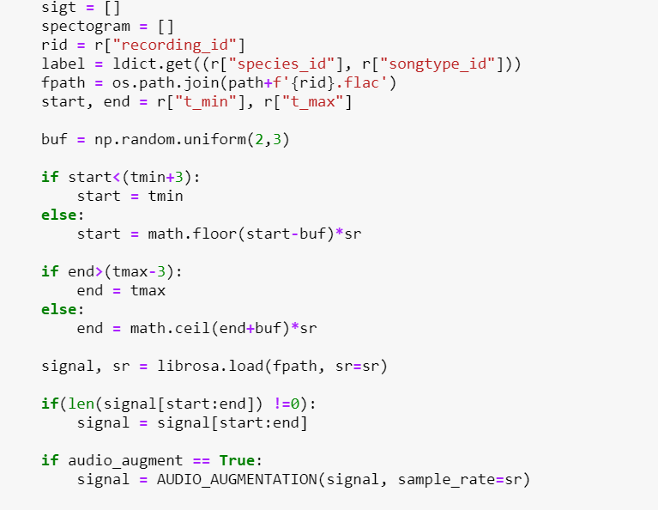
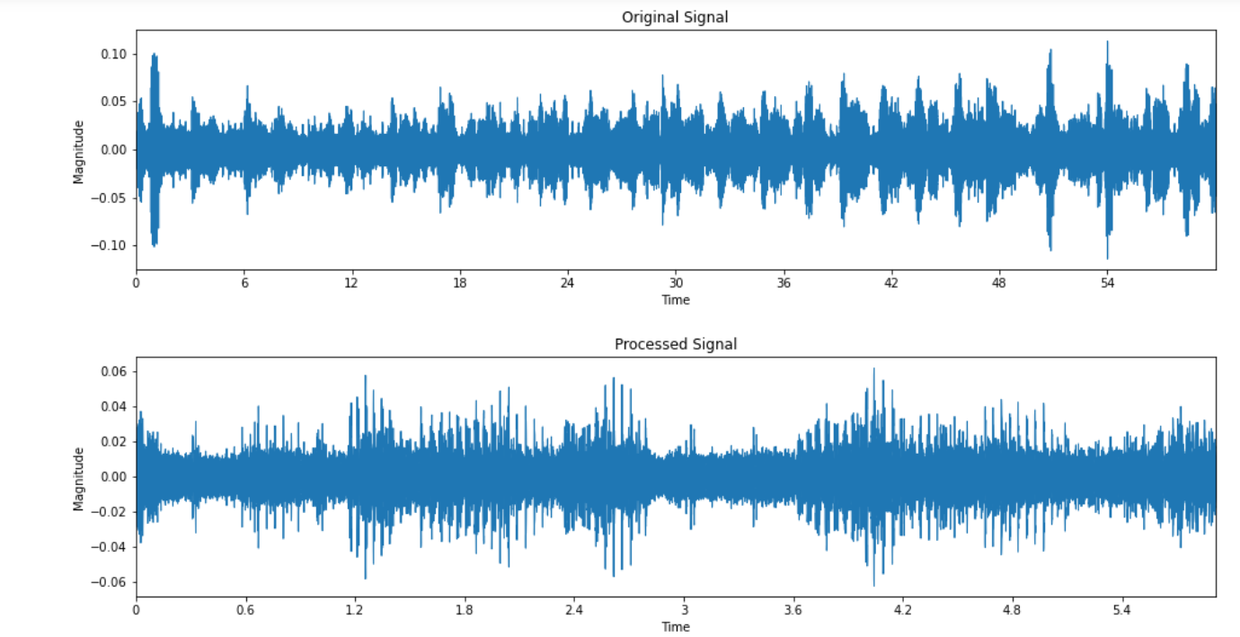
Signal Processing

Slide 19
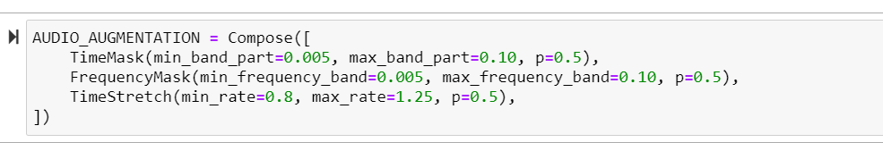
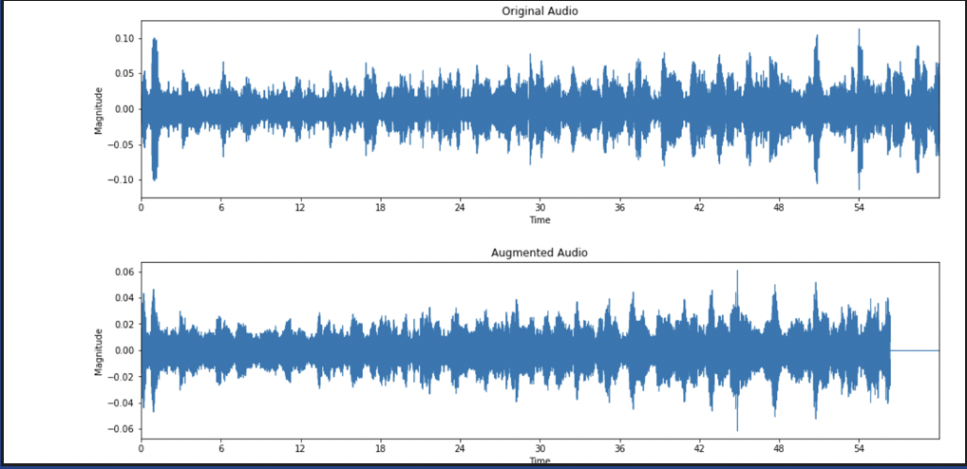
AUDIO AUGMENTATION

Slide 20

FEATURE EXTRACTION
We use three types of feature extractors for the model and select the one which provides best features.
The combinations of feature extractors are:
Mel-Frequency Cepstral Coefficient(MFCC) + Log Scale-Mel Spectrogram
STFT ( Short time Fourier transformation)+Mel-Frequeny Cepstral Coefficient (MFCC)
STFT ( Short time Fourier transformation)+Log Scale-Mel Spectrogram

Slide 21
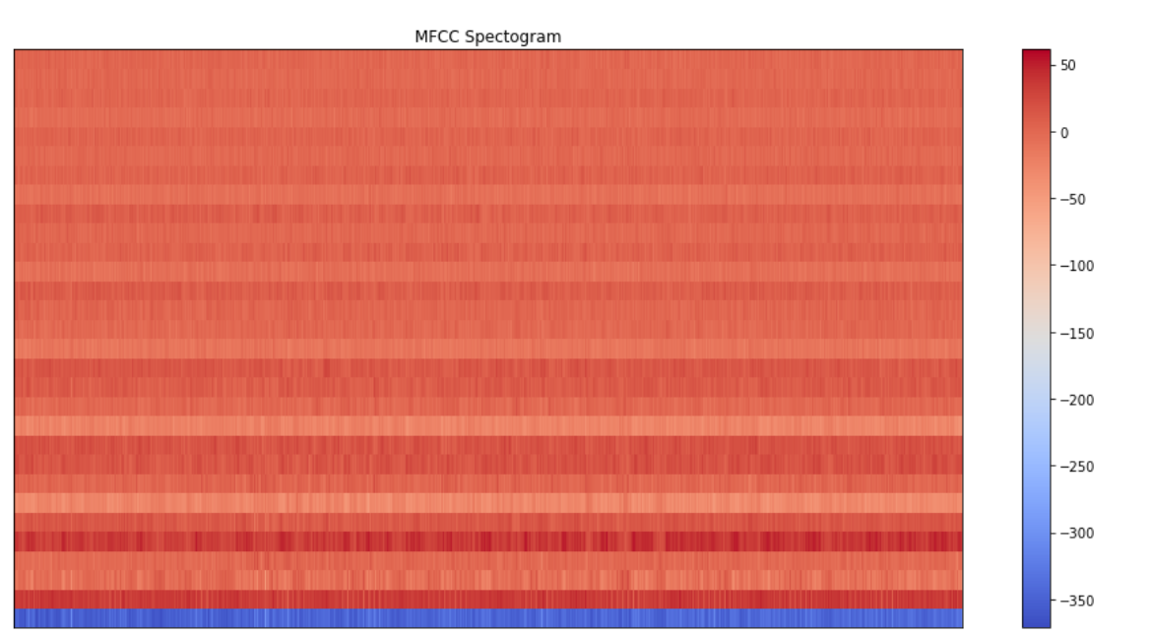
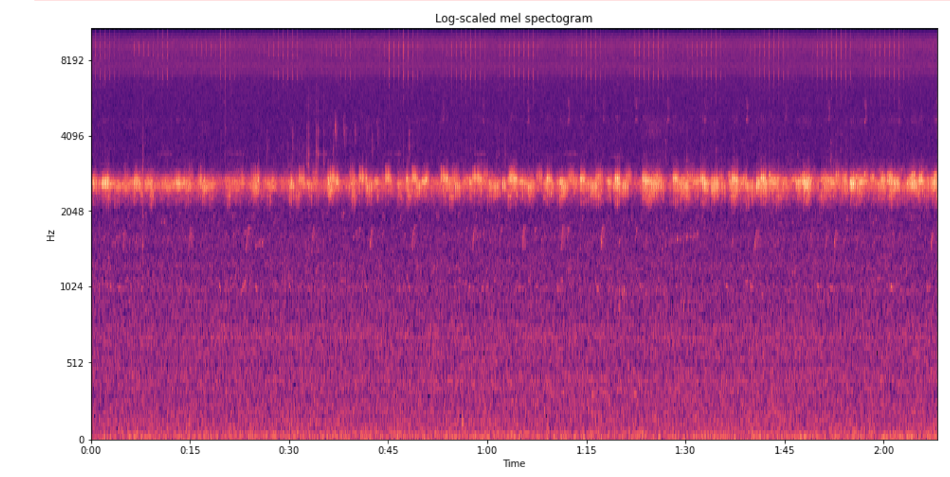
MFCC, STFT and LOG-MEL SPECTROGRAM
MFCC feature was extracted steps:
Applying Discrete Fourier Transformation (DFT) on each framed window.
Triangular overlapping frames.
Logarithm of the amplitude spectrum is calculated.
Discrete cosine transformation to result spectrogram.
STFT:
Proper pre-processing of the raw data is important to achieve better accuracy.
So, STFT ( Short time Fourier transformation) was extracted in addition to MFCC
Log-Mel Spectogram:
Generally, in Mel-spectrogram the frequencies are converted to the mel scale but in log-mel spectrogram
In log-mel spectrogram we convert the y-axis (frequency) to a log scale and the color dimension (amplitude) to decibels to form the spectrogram.

Slide 22
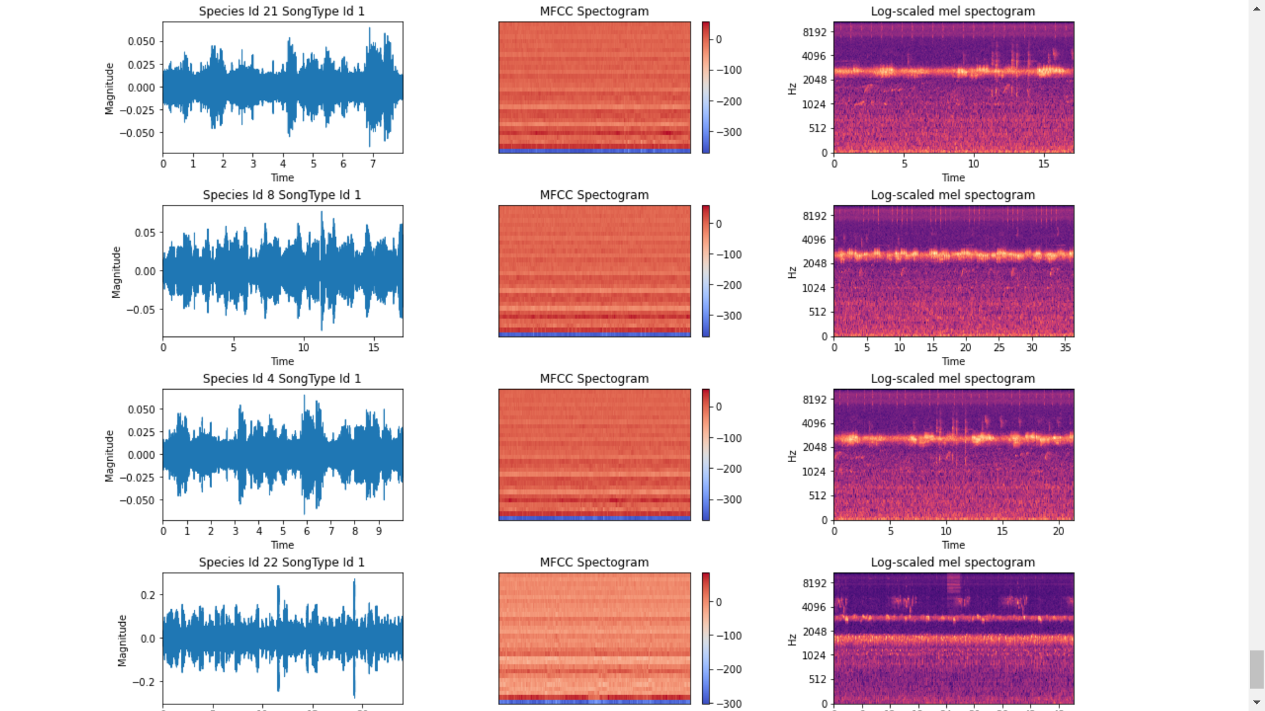
MFCC AND LOG-MEL SPECTROGRAM

Slide 23
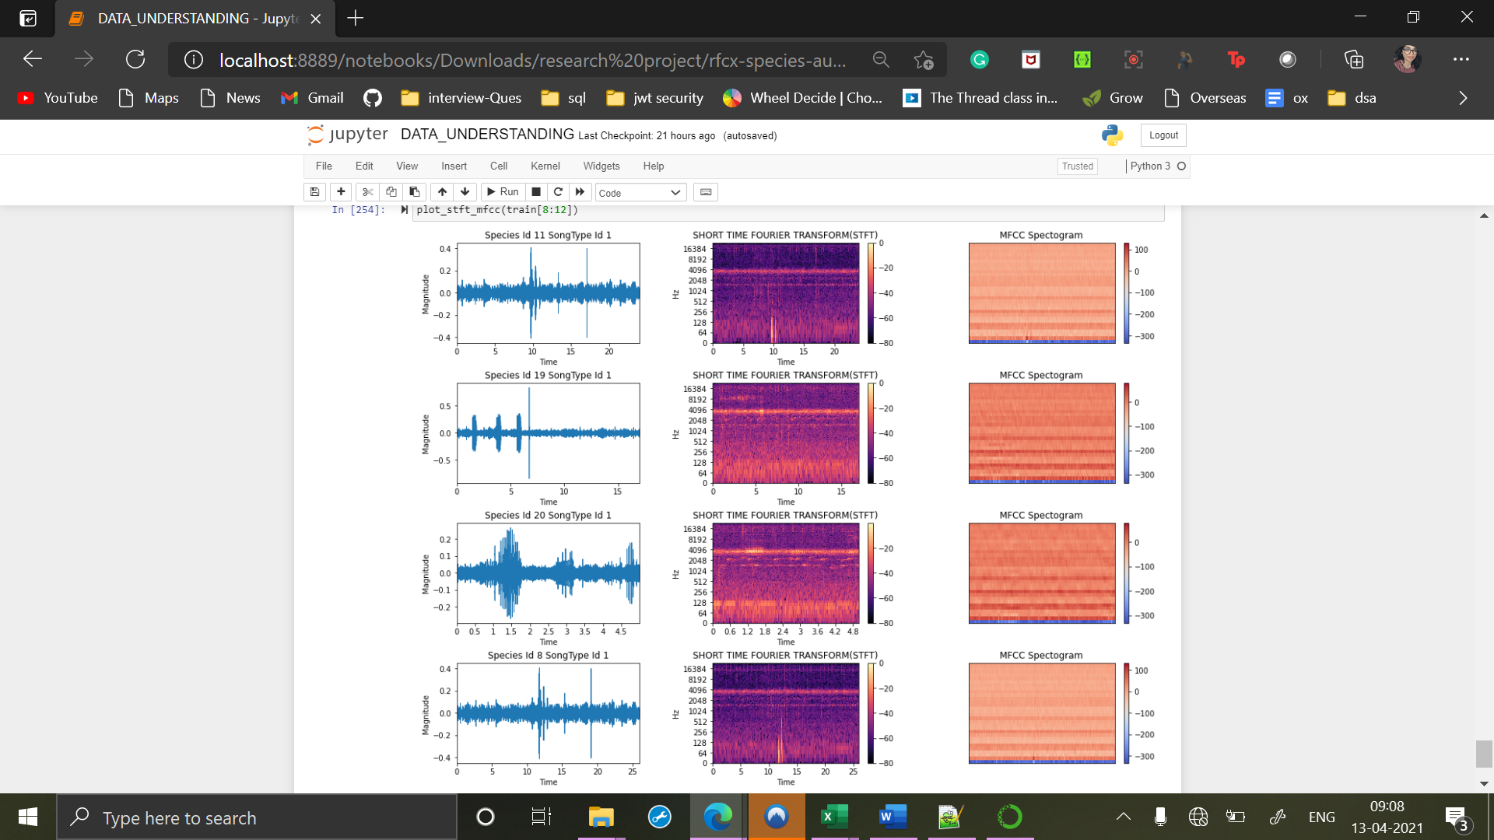
STFT +MFCC

Slide 24
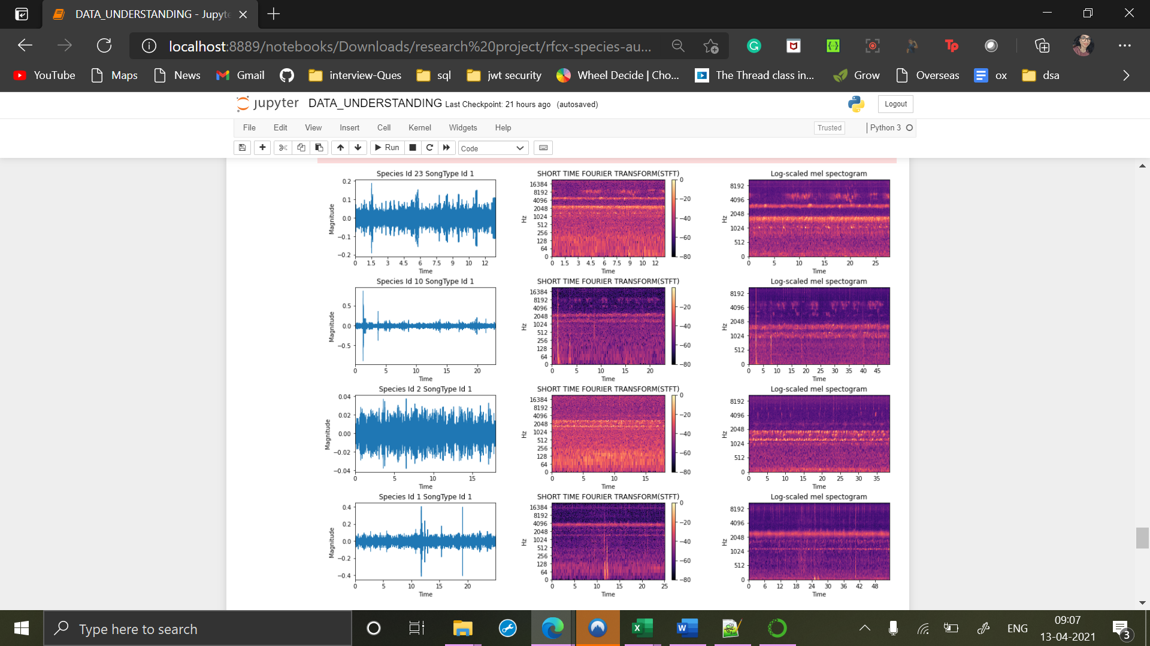
STFT +Log-MEL scaled spectrogram

Slide 25
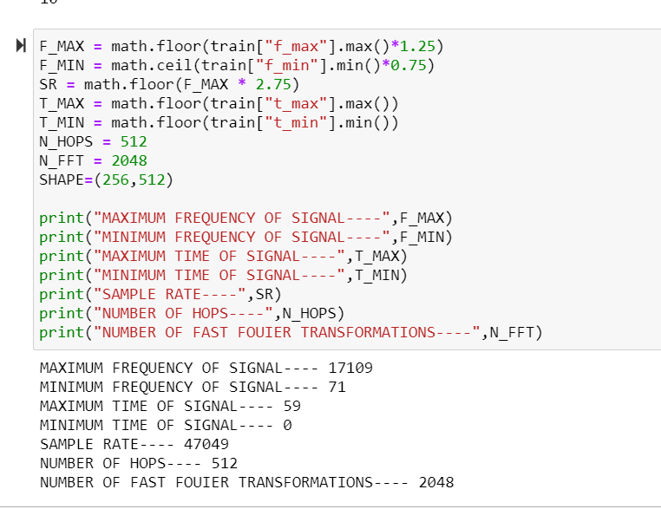
Important variable for feature extraction

Slide 26
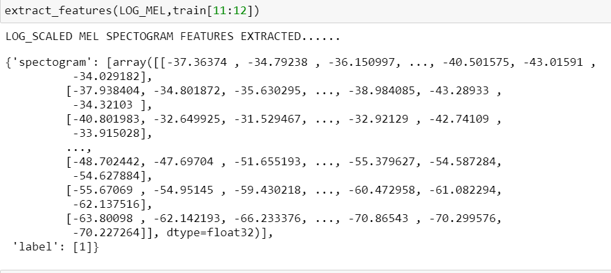
Feature Extraction for log_mel

Slide 27
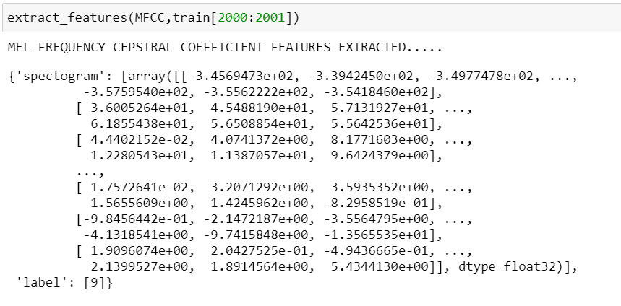
Feature Extraction for MFCC

Slide 28
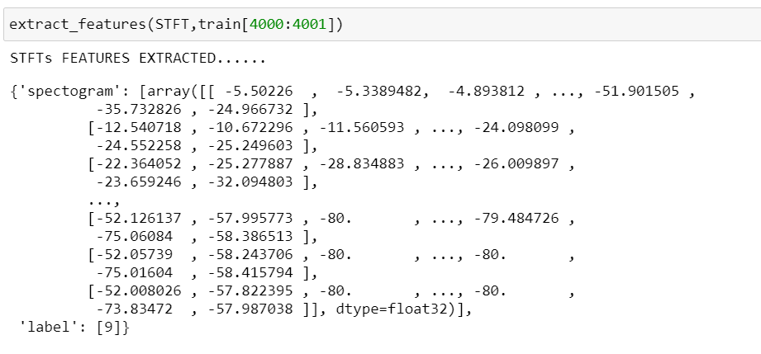
Feature Extraction for STFT

Slide 29
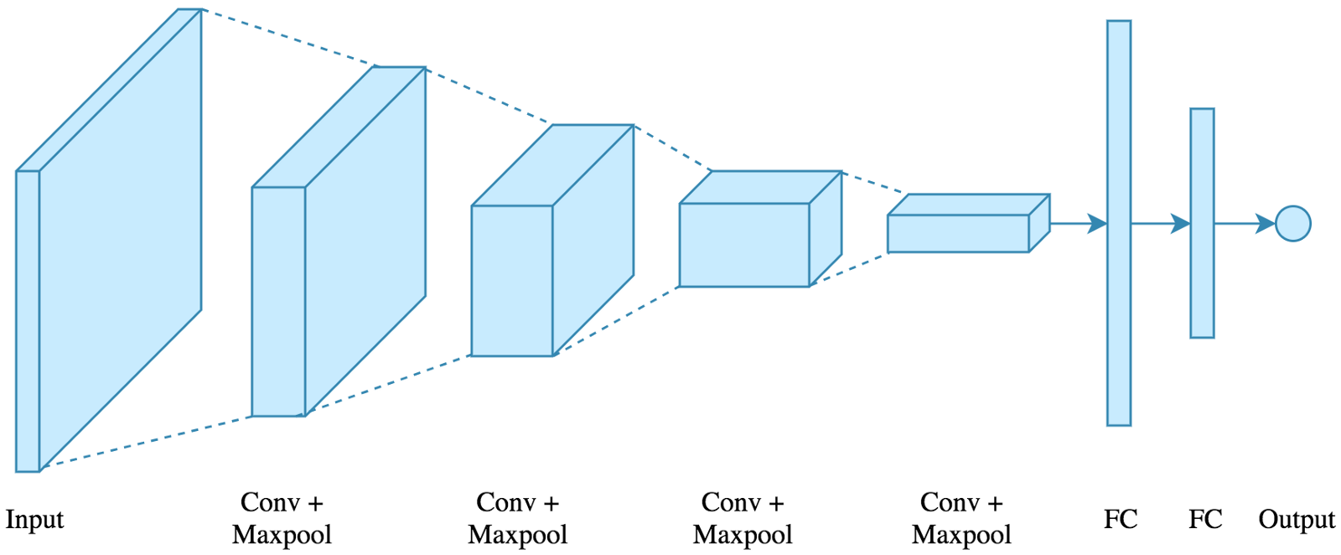
DATA CLASSIFICATION
This is the final and most important step in our training process.
We use Convolutional neural network as our classification technique because it is quite powerful neural network for image recognition that any other neural networks.
And recently it is shown that CNN has also been widely used in speech and acoustic classification and detection
Basic CNN Architecture

Slide 30

PROPOSED CNN MODEL
We are going to use Leaky RELU ( Rectified Linear Unit) as our activation function which inherits the non-linear and low computational complexity properties of RELU.
Since our data is a large and complex we are not going to use traditional RELU function where there is chance of loosing 50% of data
So for every layer in CNN it will arrange the input as a set of liner activation using a Leaky RELU
After each activation function, a Batch normalization is added in order to stabilize and speed up the training process

Slide 31
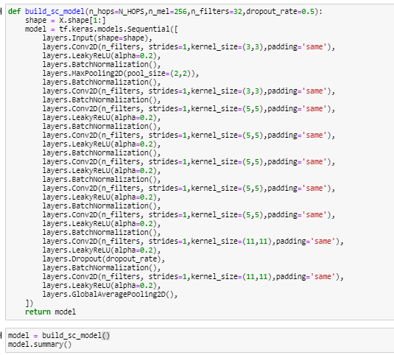
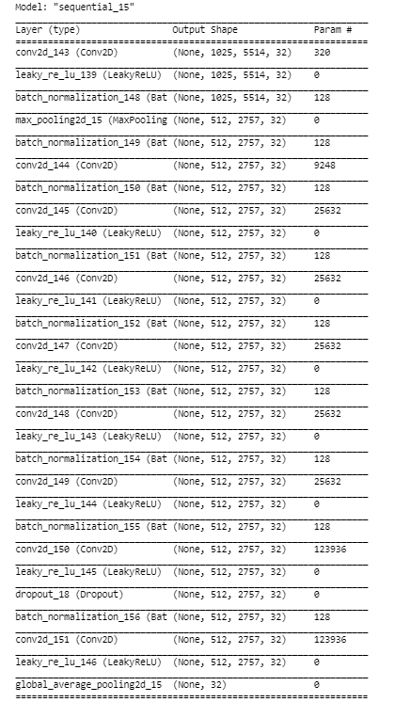

CNN-Model

Slide 32
Challenges
Huge time processing for each feature extraction.
MFCC spectrogram complexity.

Slide 33
Next Steps
Training model with different combinations of spectrograms.
Test model
Evaluate the model
Best model

Slide 34
Conclusion
Use of data mining techniques to solve the problem.
Improvised method – parallel computation model.

Slide 35
REFERENCES
Models and layers | TensorFlow.js
https://librosa.org/doc/latest/index.html
https://pypi.org/project/audio-augmentations/
Salamon,J., & Bello,J.P.(2017). Deep Convolutional neural networks and data augmentation for environmental sound classification. IEEE Signal Processing Letters, 24(3), 279-283
M.-T. Chen, B.-J. Li, and T.-S. Chi, “Cnn based two-stage multiresolution end-to-end model for singing melody extraction,” in ICASSP 2019-2019 IEEE International Conference on Acoustics, Speech and Signal Processing (ICASSP). IEEE, 2019, pp. 1005–1009.
K. Choi, G. Fazekas, M. Sandler, and K. Cho, “Convolutional recurrent neural networks for music classification,” in 2017 IEEE International Conference on Acoustics, Speech and Signal Processing (ICASSP). IEEE, 2017, pp. 2392–2396.
S. Dieleman, P. Brakel, and B. Schrauwen, “Audio-based music classification with a pretrained convolutional network,” in ISMIR, 2011.
X. Zhang, Y. Zou and W. Shi, "Dilated convolution neural network with LeakyReLU for environmental sound classification," 2017 22nd International Conference on Digital Signal Processing (DSP), London, 2017, pp. 1-5, doi: 10.1109/ICDSP.2017.8096153.
A. Dang, T. H. Vu and J. Wang, "Acoustic scene classification using convolutional neural networks and multi-scale multi-feature extraction," 2018 IEEE International Conference on Consumer Electronics (ICCE), Las Vegas, NV, 2018, pp. 1-4, doi: 10.1109/ICCE.2018.8326315.
T. Doan, H. Nguyen, D. T. Ngo, L. Pham and H. H. Kha, "Acoustic Scene Classification Using A Deeper Training Method for Convolution Neural Network," 2019 International Symposium on Electrical and Electronics Engineering (ISEE), Ho Chi Minh, Vietnam, 2019, pp. 63-67, doi: 10.1109/ISEE2.2019.8921365.
https://www.kaggle.com/c/rfcx-species-audio-detection/overview
X. Zhang, Y. Zou and W. Shi, "Dilated convolution neural network with LeakyReLU for environmental sound classification," 2017 22nd International Conference on Digital Signal Processing (DSP), London, 2017, pp. 1-5, doi: 10.1109/ICDSP.2017.8096153.

